Slide 1
Mottled Stars - Methodology
How Does Starspot Coverage Affect Stellar Brightness Variability?
Miles L. Johnson, Gregory A. Feiden

Slide 2
Mottled Stars
Starspots can cause either superficial changes to the observable properties of a star or cause deep structural changes
In order to understand this process, we investigate how starspots affect a star’s brightness over time

Slide 3
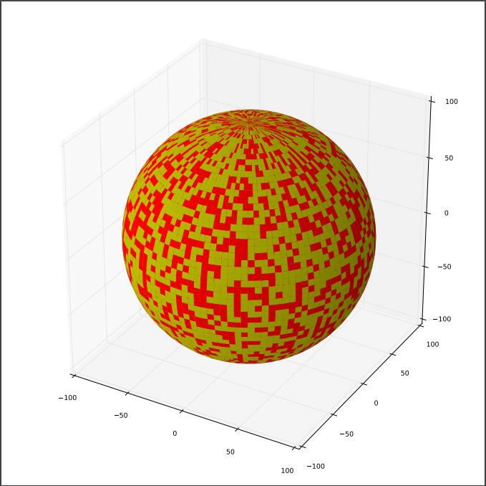
Building 3-D Stellar Models
We took a practical approach to the construction of our stellar models
This started with creating a three-dimensional model sphere in our preferred programming language
The surface of the stellar model needed to be tessellated with many small rectangular cells
Code was written that randomly selected cells to be ‘spot cells’ at any given surface coverage

Slide 4
3-D Model to 2-D Projection
To calculate the observed luminosity of our stellar model, we projected the observed hemisphere of our model onto a square
A projection was chosen that preserves observed surface area
Surface area is directly proportional to luminosity
Therefore, we observe the edges of the observed hemisphere to be dimmer than the center

Slide 5
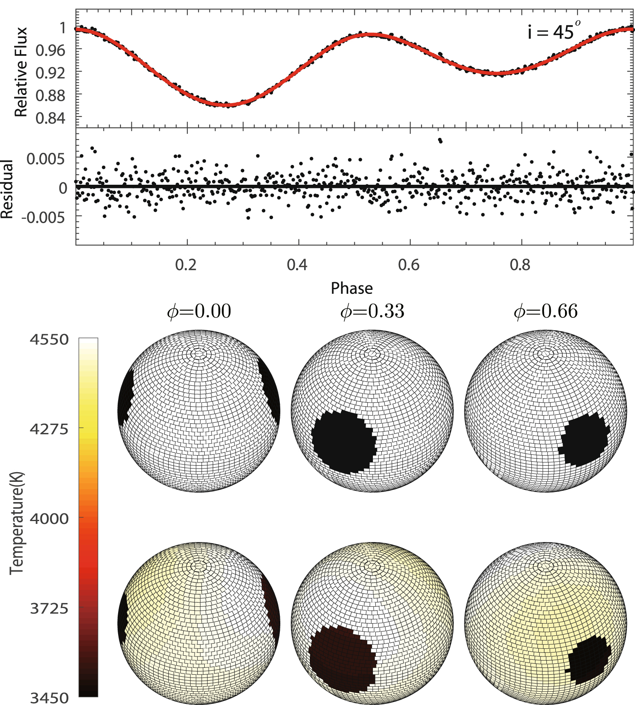
Luminosity Integration
To simulate changes in luminosity in our models as a function of time, the stellar model would be rotated
With each discrete rotation, a new projection of the observed hemisphere is produced
After a complete rotation, the observed luminosity from each projection is summed, and plotted against rotational (phase) angle
This is known as a light curve
Image Credit:

Slide 6
References
Gough, D. (2010). Vainu Bappu Memorial Lecture: What is a Sunspot? Cambridge, UK. Institute of Astronomy, University of Cambridge, U.K.
Kutner, M. (2003). Astronomy : a physical perspective. Cambridge, U.K. New York: Cambridge University Press.

